Slide 1
Value Chain Dynamics:
When Technologies and Business Models Collide
Charles Fine (charley@mit.edu)
Chrysler LGO Professor of
Management and Engineering Systems,
MIT Sloan School and
Engineering Systems Division
Excerpts from
MIT CFP
November 2012

Slide 2
Technology and Industry Disruptions
Industry
Disruption
No Industry
Disruption
Weak Incumbent
Network Effect
• Strong Entrant
Network Effect
Incumbents can affect
switching behavior
Digital
music
Incumbents innovate
while maintaining quality
• Incumbents control
complementary assets
Electric
vehicles
Technology
Disruption
Consumer highly price
sensitive and willing to
risk adopting innovative
service with low quality
and compatibility
Entrants struggle to
offer quality due to lack
of functional control
or market power
Quadrant Not Relevant
Strong Incumbent
Network Effect
Linux vs.
Windows
No
Technology
Disruption
Consumers value quality
and compatibility over
innovation and low price

Slide 3
Sometimes innovation involves “co-opetition:” Horizontal and Vertical Competition in the Value Chain
AT&T
Verizon
Apple
Samsung
Google Nexus
Apple ios
Android
Hynix
Samsung

Slide 4
PCAST report concludes
spectrum scarcity 'an illusion’ *
RADICAL CHANGE: Make way for
"a new spectrum architecture and a corresponding
shift in the architecture of future radio systems that use it."
Incremental Suggestions:
Leverage technology to allows devices to
share spectrum with federal users
Work to make federal users more spectrum efficient
Dynamic assignment
Short term licenses
Improved agency incentives
*http://broadcastengineering.com/legislation/pcast-report-concludes-spectrum-scarcity-illusion

Slide 5
Three Lenses on Change
Rational
Organizations are machines
An organization is a mechanical system crafted to achieve a defined goal. Parts must fit well together and match the demands of the environment. Action comes through planning.
Political
Organizations are contests
An organization is a social system encompassing diverse, and sometimes contradictory, interests and goals. Competition for resources is expected. Action comes through power.
Cultural
Organizations are institutions
An organization is a symbolic system of meanings, artifacts, values, and routines. Informal norms and traditions exert a strong influence on behavior. Action comes through habit.

Slide 6
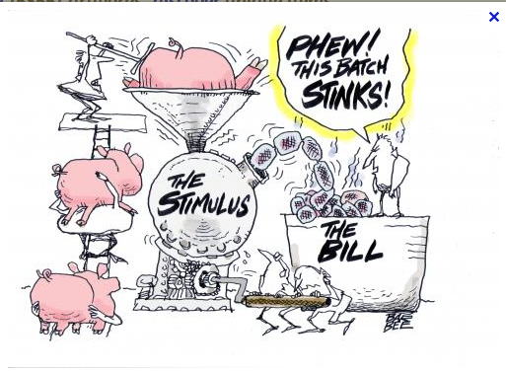
PEOPLE WHO LIKE SAUSAGE OR TRUST THE LAW SHOULDN’T WATCH HOW EITHER IS MADE.

Slide 7
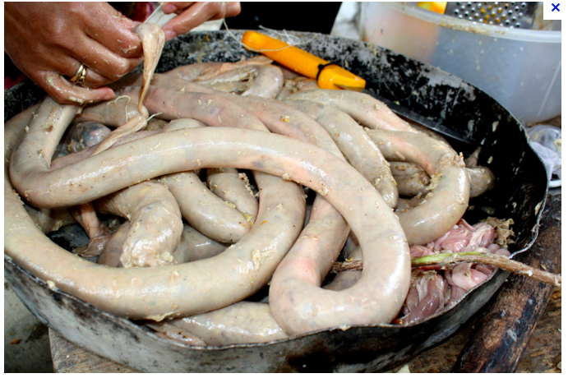

Slide 8
A simple model of sausage making
Step 1: Incumbent lobbying works
Incumbent
Growth
-
+
Incumbent
Lobbying
Investment
+
Open Spectrum
Made Available
By FCC
-
+
Strength of
Incumbent
Case

Slide 9
A simple model of sausage making
Step 2: Incumbent litigation works
-
Court
support
of Open
Spectrum
Incumbent
Litigation
Investment
+
Incumbent
Growth
-
+
Incumbent
Lobbying
Investment
+
Open Spectrum
Made Available
By FCC
-
+
Strength of
Incumbent
Case

Slide 10
A simple model of sausage making
Step 3: Entrant lobby counterbalance
-
+
Court
support
of Open
Spectrum
+
Incumbent
Litigation
Investment
+
Incumbent
Growth
Entrant
Profitability
+
New
Services
offered
-
+
+
+
Incumbent
Lobbying
Investment
+
Entrant
Lobbying
Investment
+
+
Open Spectrum
Made Available
By FCC
Consumer
Dissatisfaction
+
-
+
+
Strength
of Entrant
Case
+
Strength of
Incumbent
Case
Legislative
Sympathy for
Entrant
+
-

Slide 11
Step 4: Arms race and/or gridlock; How to get to win-win?
-
+
Court
support
of Open
Spectrum
+
Entrant
Litigation
Investment
Incumbent
Litigation
Investment
+
Incumbent
Growth
Entrant
Profitability
+
New
Services
offered
-
+
+
+
Incumbent
Lobbying
Investment
+
Entrant
Lobbying
Investment
+
+
Open Spectrum
Made Available
By FCC
Consumer
Dissatisfaction
+
-
+
+
Strength
of Entrant
Case
+
Strength of
Incumbent
Case
Legislative
Sympathy for
Entrant
+
-

Slide 12
AT&T shreds PCAST's shared spectrum vision*
US Lawmakers Question Plans
for Spectrum Sharing**
ITIF's Bennett says
PCAST Spectrum Report Impractical***
*http://www.fiercebroadbandwireless.com/story/att-shreds-pcasts-shared-spectrum-vision/2012-08-05
**http://www.pcworld.com/article/262290/us_lawmakers_question_plans_for_spectrum_sharing.html
***http://www.itif.org/pressrelease/itifs-bennett-says-pcast-spectrum-report-impractical

Slide 13
Innovation Dynamics can be RADICAL (disruptive) or INCREMENTAL (sustaining) THE MECHANISMS ARE DIFFERENT
Performance
Time
Notes:
17
6

Slide 14
What makes an innovation disruptive?
Performance Push
an overwhelmingly superior technology/process
(mass production, penicillin)
Customer Pull
new customers care about different measures of performance
(wireless phones, personal computers)
Organizational Competencies
incumbents cannot do what the innovators can
(Dell supply chain, Southwest Air)

Slide 15
THE DYNAMICS OF PRODUCT ARCHITECTURE,
STANDARDS,AND VALUE CHAIN STRUCTURE:
“THE DOUBLE HELIX”
INTEGRAL PRODUCT
VERTICAL INDUSTRY
PROPRIETARY STANDARDS
MODULAR PRODUCT
HORIZONTAL INDUSTRY
OPEN STANDARDS
NICHE
COMPETITORS
INNOVATION & TECHNICAL ADVANCES
HIGH-
DIMENSIONAL
COMPLEXITY
SUPPLIER
MARKET POWER
PRESSURE TO
DIS-INTEGRATE
INCENTIVE TO
INTEGRATE
ORGANIZATIONAL
RIGIDITIES
PROPRIETARY SYSTEM
PROFITABILITY
A PARABLE OF DINOSAURS AND FRUIT FLIES
C. FINE, CLOCKSPEED, PERSEUS BOOKS, 1998.

Slide 16
ALL COMPETITIVE ADVANTAGE
IS TEMPORARY
Autos:
Ford in 1920, GM in 1955, Toyota in 2000
Computing:
IBM in 1970, Wintel in 1990, Apple in 2010
World Dominion:
Greece in 500 BC, Rome in 100AD, G.B. in 1800
Sports:
Red Sox in 2007, Celtics in 2008, Yankees in 2009
The faster the clockspeed, the shorter the reign

Slide 17
“Gear Model” to support Roadmapping of
Value Chain Dynamics (VCD)
Corporate
Strategy
Dynamics
Regulatory
Policy
Dynamics
Technology
& Innovation
Dynamics
Industry
Structure
Dynamics
Customer
Preference
Dynamics
Business
Cycle
Dynamics
Capital
Market
Dynamics
Gears differ by size/speed
Each has an engine & clutch

Slide 18
Communications Value Chain Roadmap Consortium
MATERIALS &
PROCESS EQUIP
COMP-
ONENTS
EQUIPMENT
MAKERS
NETWORK
OWNERS
SERVICE
PROVIDERS
CONTENT
DEVICES
END
USERS
3M Applied Materials Dupont Newport Shipley Sagitta STS Sumitomo Veeco Unaxis Etc.. | Agere Agilent Alcatel Analog Devices Bookham Corning Finisar JDSU Nortel TI Etc.. | Alcatel Ciena Cisco Fujitsu Lucent Marconi Nortel Siemens Sycamore Etc.. | AT&T BellSouth BT Level3 Qwest SBC Sprint Verizon Williams Worldcom Etc.. | AT&T BellSouth AOL/TW Earthlink NBC Prodigy Scientific Atlanta United Online Verizon Etc.. | AOL/TW Disney EMI Microsoft NBC The News Corporation Viacom Yahoo • VoIP Etc.. | Computers Phones Media Players • Cameras PDA’s Etc..
Business
Consumer
Gov’t
Education
Medical
Etc..
CROSS-INDUSTRY CHALLENGES
Architecture
Protocols
Devices
Regulations
And more . . .
Which parts of the chain
get commoditized?
C. Fine & E. Bruce, 2002

Slide 19
Collaborative Roadmapping
in the Semiconductor Industry:
Initiation in mid-1980’s in the U.S. at the industry and government level:
12 largest U.S. semiconductor firms,
Department of Defense, Department of Justice
Coordinate the supply chain: 150 suppliers
-- Leverage scale & scope of the whole industry
Guided by Moore’s Law (technology roadmap):
-- Ambitious goals for technological achievement
“Field of Dreams” Business Model
“If you build it, they will come.”
(There was not a sophisticated business model at that time; now there is.)

Slide 20
Industry Roadmapping: What are the Lessons?
Engage the entire value chain
All the major players -- OEM’s and Suppliers
-- Achieve scale economies in R&D and Manufacturing
Intellectual Value Chain -- Technologists and Scholars
Government agencies and regulators
Build parallel, interlocking roadmaps
Technology Roadmap
Business and Industry Roadmap
Regulatory Roadmap
Build consensus around a common vision and leadership
In Semiconductors: Moore’s Law
In Vehicle Lightweighting: Total mass and fuel economy
In Communications: Spectrum Capacity?
Industry Leaders and Visionaries Must Lead
Build Collaborative Processes around Projects
Create cross-company working groups
-- to tackle technological challenges
-- to build and test prototypes
-- to continuously update the Roadmap

Slide 21
All Conclusions are Temporary
Clockspeeds are increasing almost everywhere
Value Chains are changing rapidly
Assessment of
value chain dynamics
Build Strategies
and Roadmaps

